Slide 1
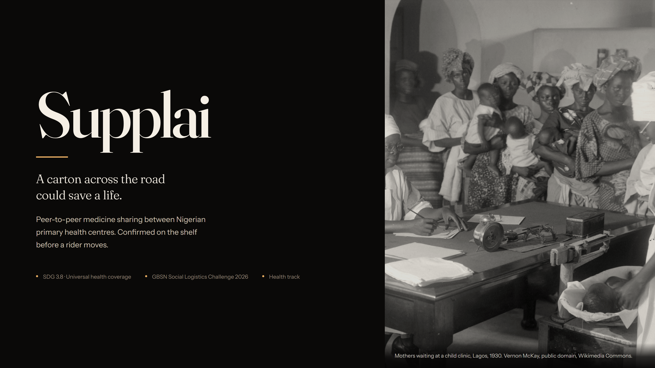
Notes:
Supplai — peer-to-peer medicine sharing between Nigerian primary health centres. The claim: a carton four kilometres away can end a stockout the same day, and the receiving clinic confirms the shelf before a rider moves.

Slide 2
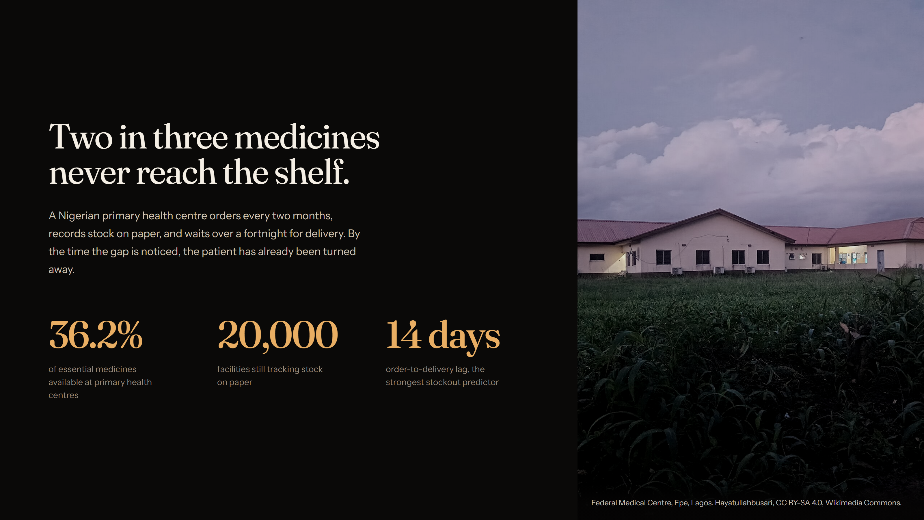
Notes:
36.2% mean availability of essential medicines at primary health centres. Around 20,000 facilities still record stock on paper. A fortnight or more between order and delivery is the strongest predictor of stockout — the gap is noticed too late to fix.

Slide 3
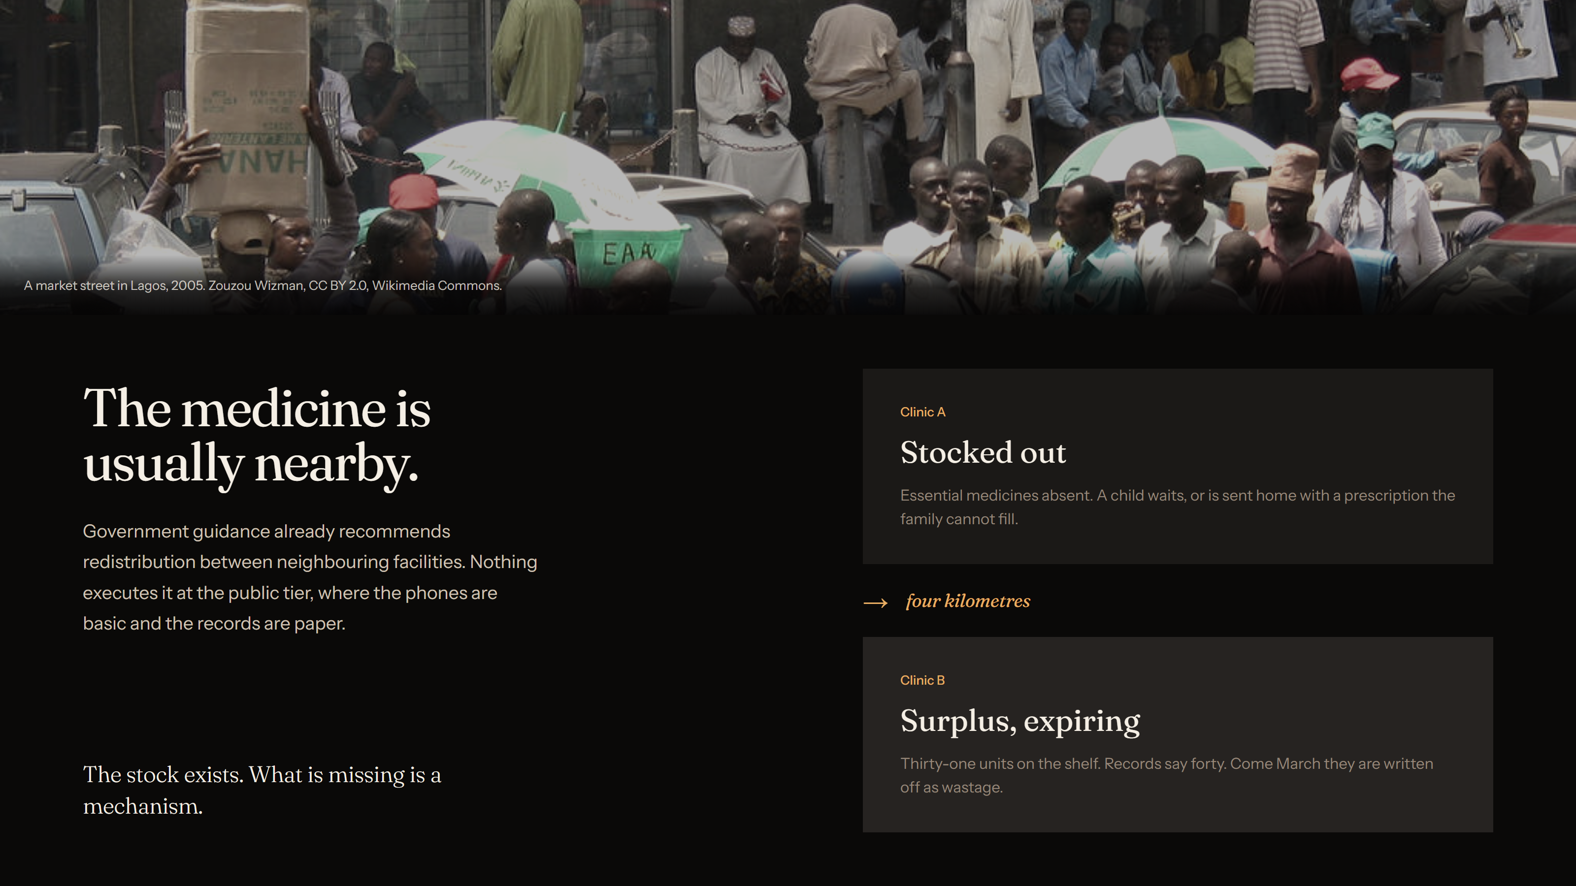
Notes:
Redistribution between neighbouring facilities is already government guidance. Nothing executes it at the public PHC tier, where phones are basic and records are paper. Clinic A is empty while Clinic B holds 31 units it will write off.

Slide 4
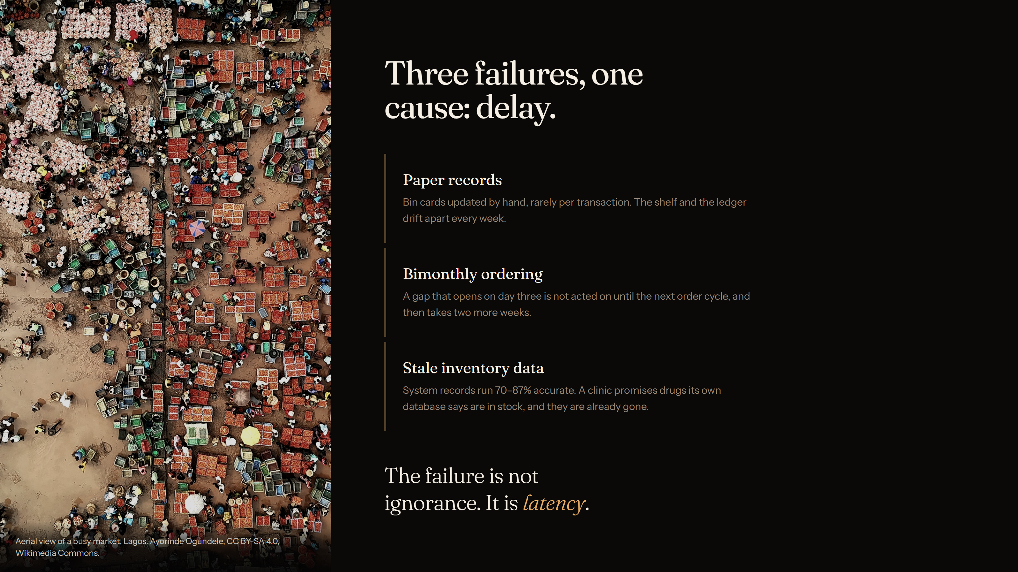
Notes:
Paper bin cards drift from the shelf. Bimonthly ordering means a gap on day three waits for the next cycle, then two more weeks. System records run 70–87% accurate, so a clinic promises stock its own database says exists. The failure is latency, not ignorance.

Slide 5
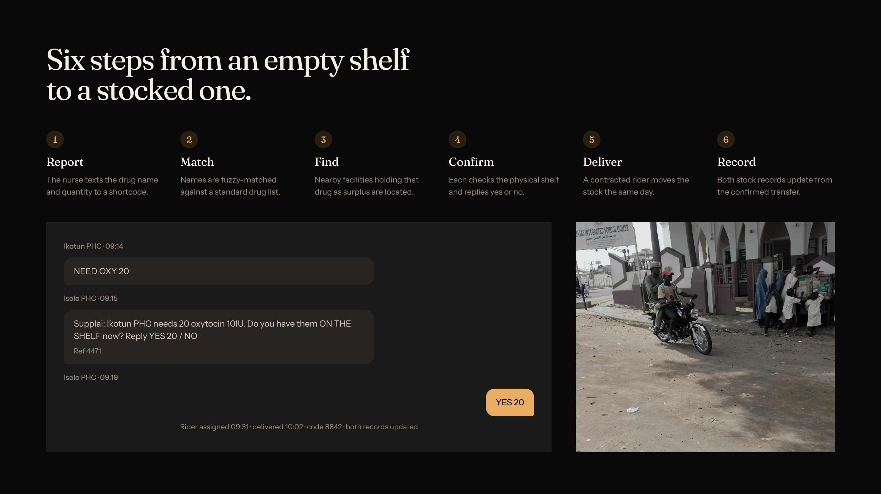
Notes:
The nurse texts a shortcode. Fuzzy matching normalises the drug name. Nearby surplus is located. Each holder is asked to check the physical shelf and reply yes or no. A rider moves it the same day. Both records update from the confirmed transfer.

Slide 6
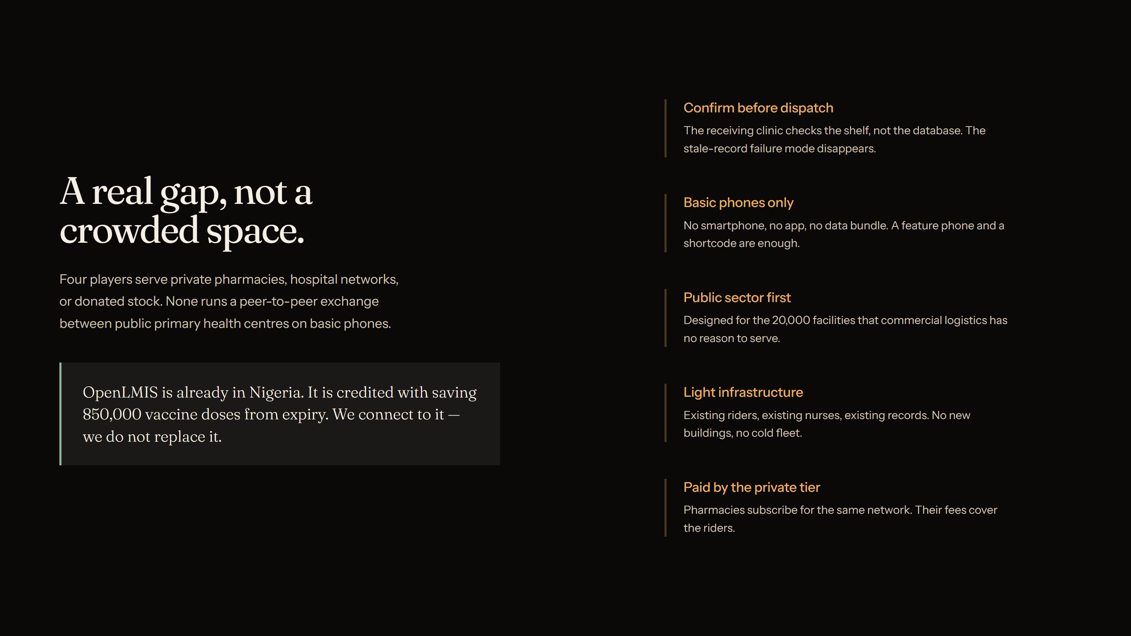
Notes:
Existing players serve private pharmacies, hospital networks or donated stock. None runs a peer-to-peer exchange between public primary health centres on basic phones. OpenLMIS is already in Nigeria and credited with saving 850,000 doses; we connect to it rather than replace it.

Slide 7
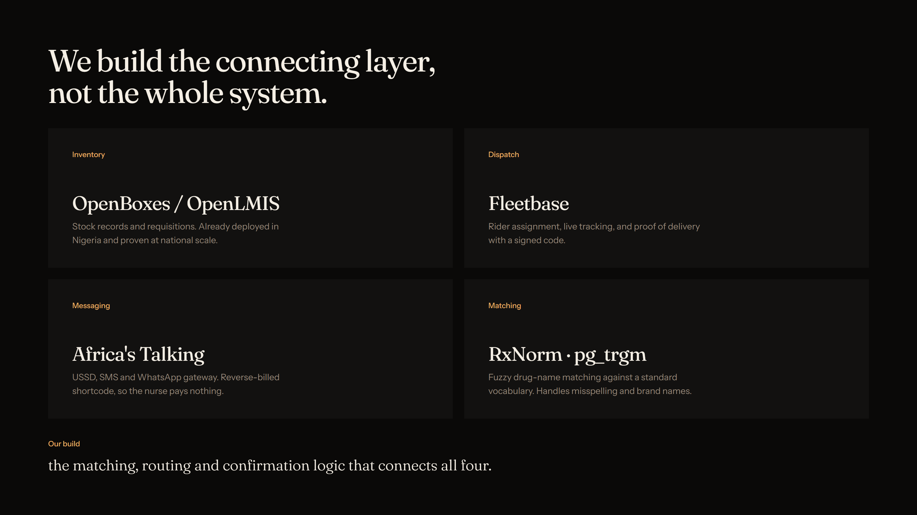
Notes:
Four proven open-source parts. We build the thin connecting layer: matching, routing and the confirmation logic that makes them behave as one service.

Slide 8
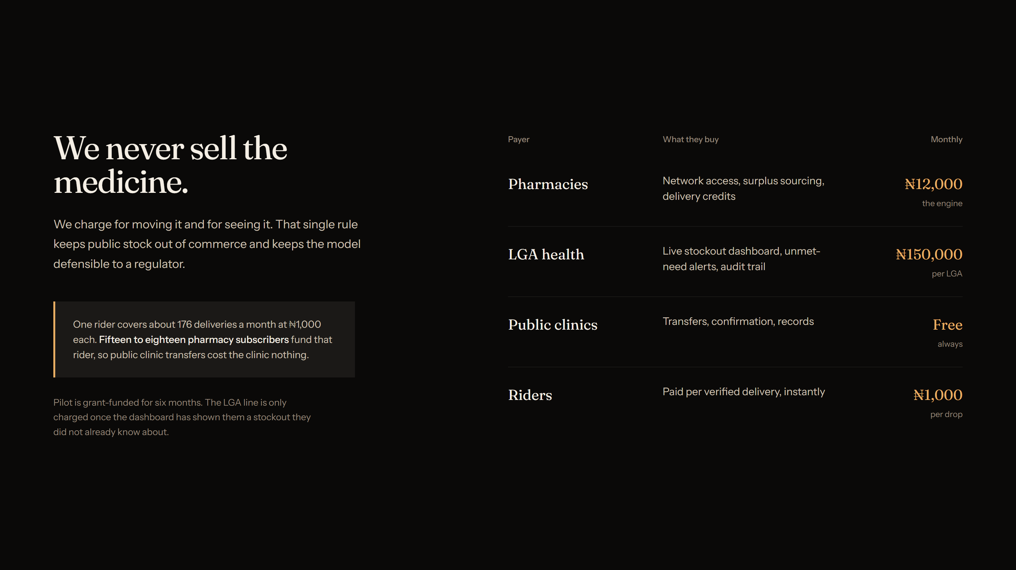
Notes:
We never sell the medicine — only movement and visibility. Pharmacies pay 12,000 naira a month, LGAs 150,000. Fifteen to eighteen pharmacy subscribers fund one rider at 176 deliveries a month, so public clinic transfers cost the clinic nothing.

Slide 9
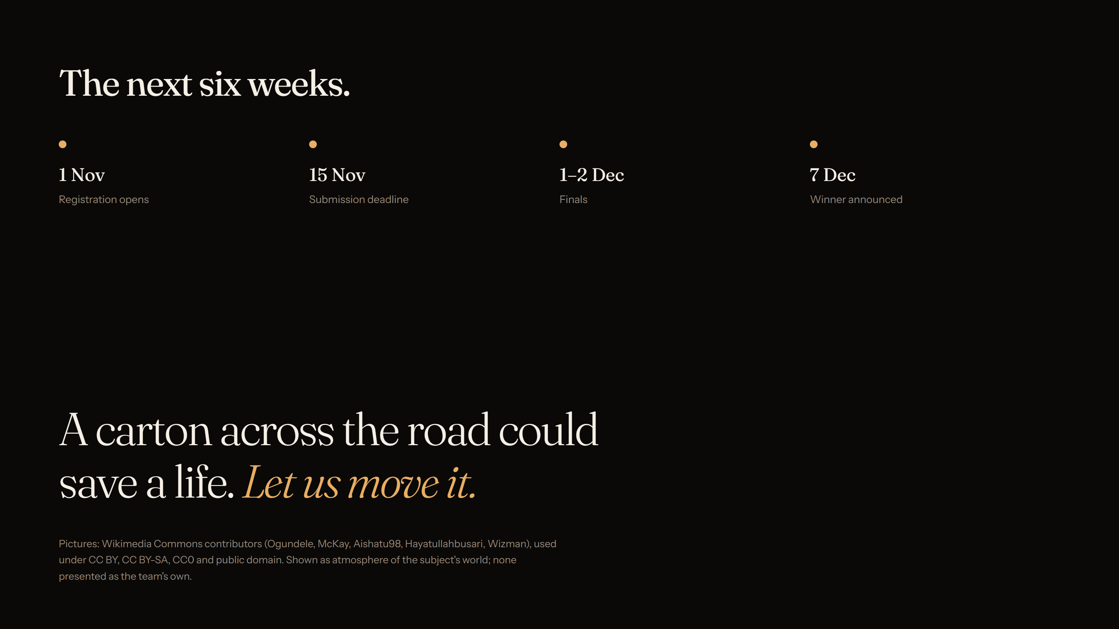
Notes:
Registration opens 1 November, submissions close 15 November, finals 1–2 December, winner announced 7 December.

